Slide 1


Slide 2

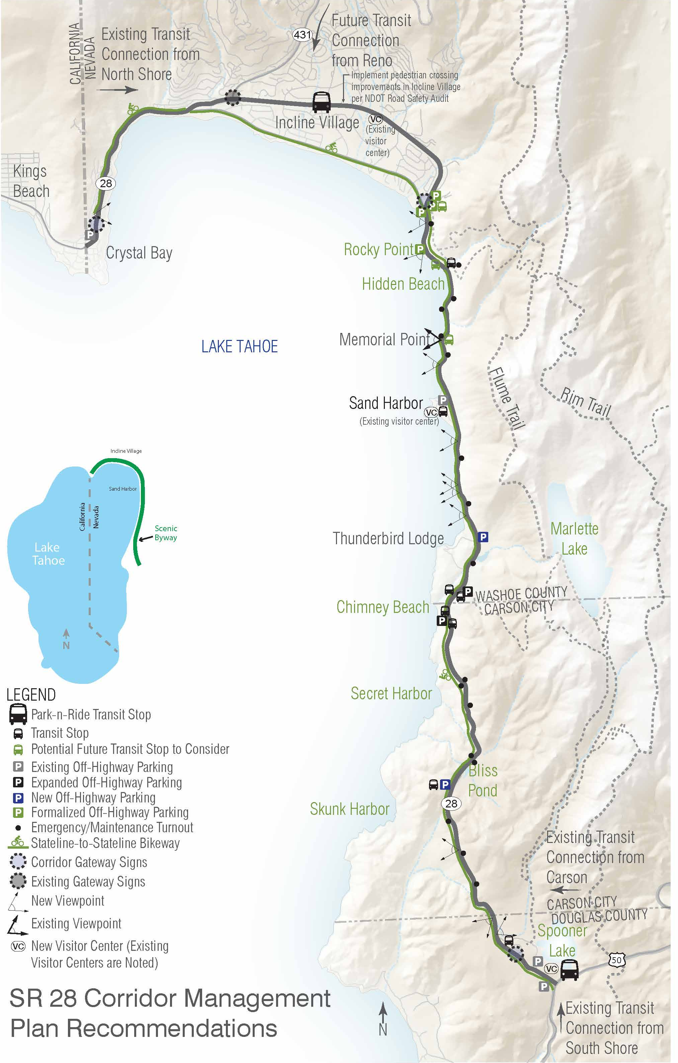
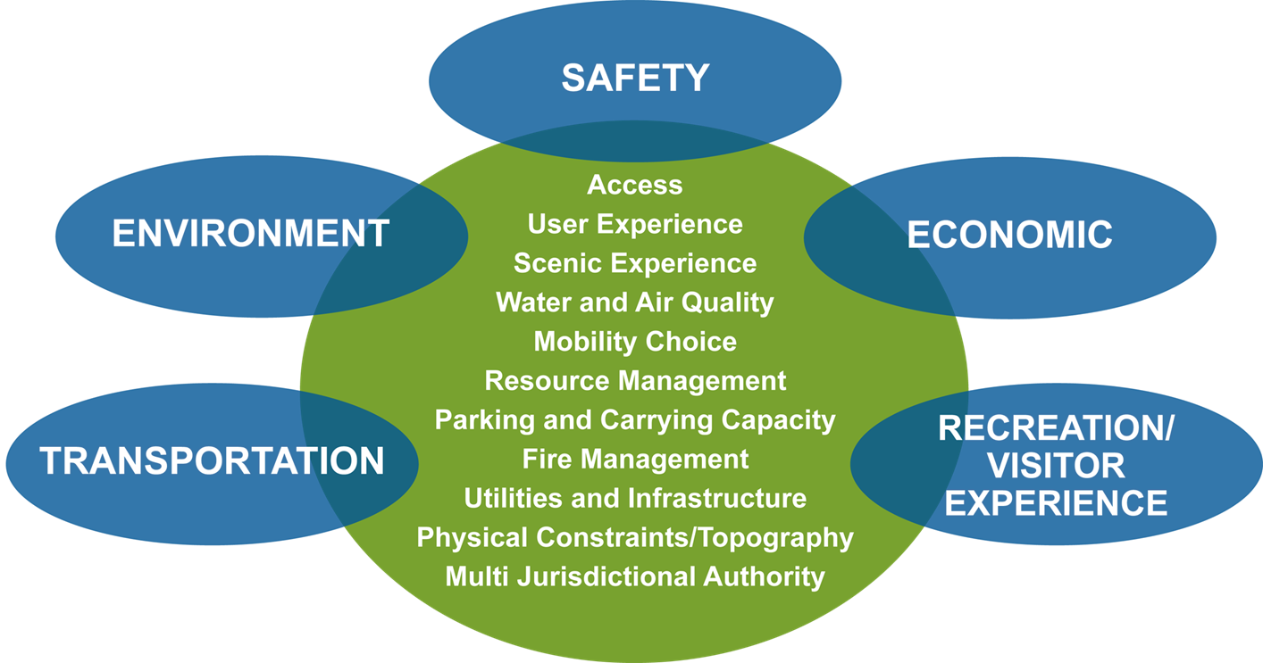
SR 28 Corridor Management Plan
Off Highway Parking
Transit
Shared Use Path
No Parking Zone/Enforcement
Coordinated O&M

Slide 3
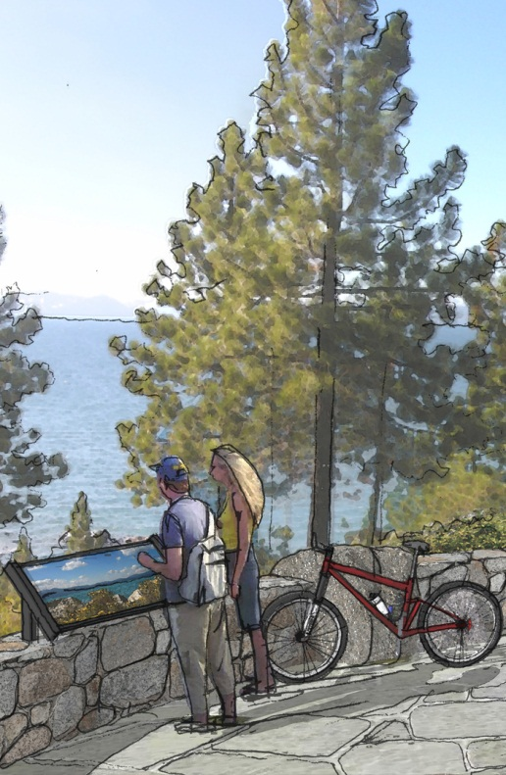
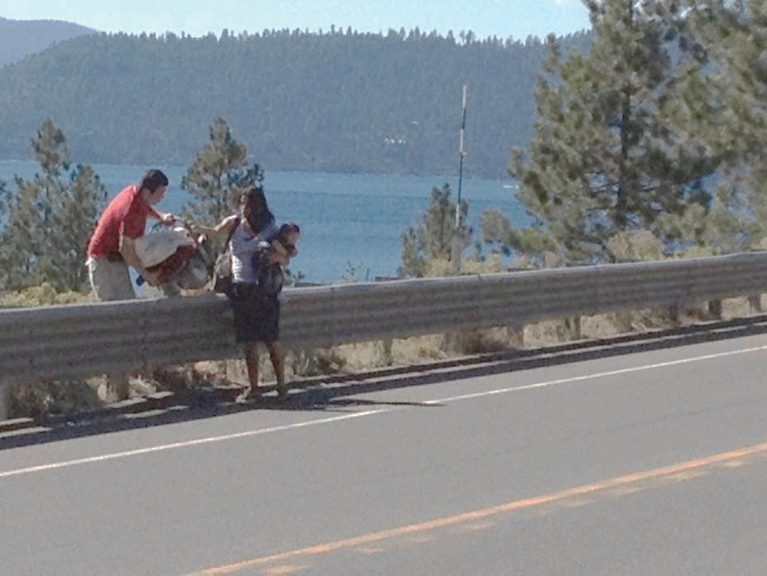
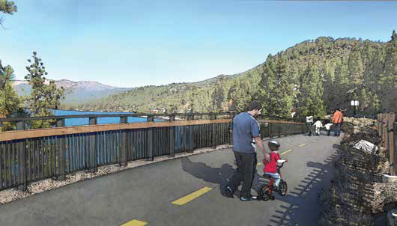
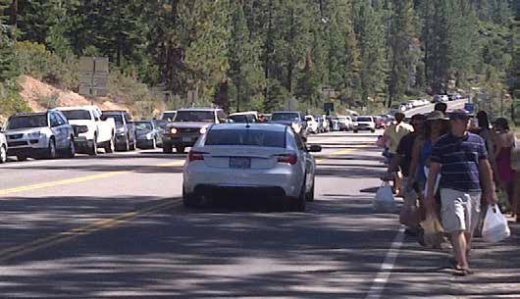

Slide 4
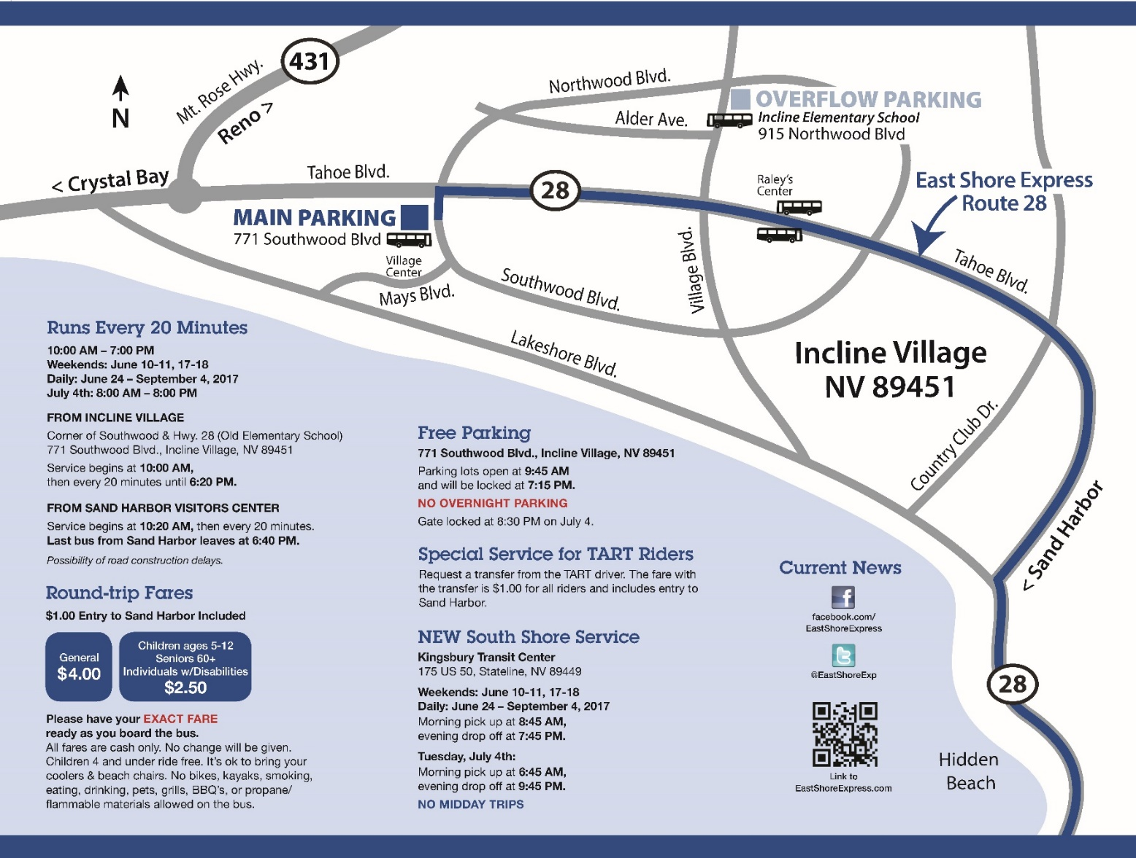
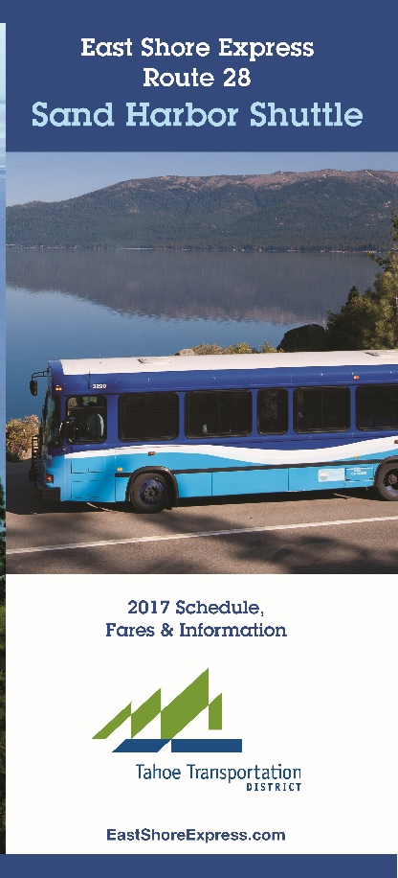
Ridership
2012 - +/-14,000
2016 – 26,473
2017 – 23,776
2018 – 35,276
Cars relocated from shoulder to Safe Parking: 500+

Slide 5
Timeline…
Nevada State Question 1 Approved – 2002 (Also Washoe County Question 1)
Interlocal Agreement Executed – 2007
Central Corridor Bikeway Feasibility Study Complete – 2011
East Shore Express startup – 2012
SR 28 Corridor Management Plan Complete – 2013
North Demo EA Completed – May 2014
SR 28 East Shore Trail (North Demo) & Safety/Water Quality Enhancements Construction Completed – 2019
Legislature State Question 1 Reauthorization – 2019
SR 28 Shared Use Path, Parking, Safety, and Environmental Improvement Project – Sand Harbor to Spooner
    - EA Completed Fall 2019
    - Estimated construction start 2022
    (Pending funding availability)

Slide 6
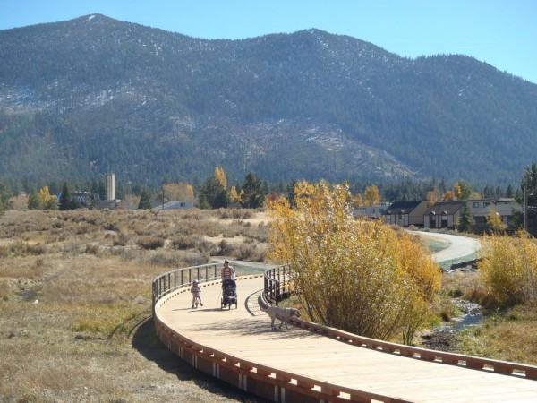
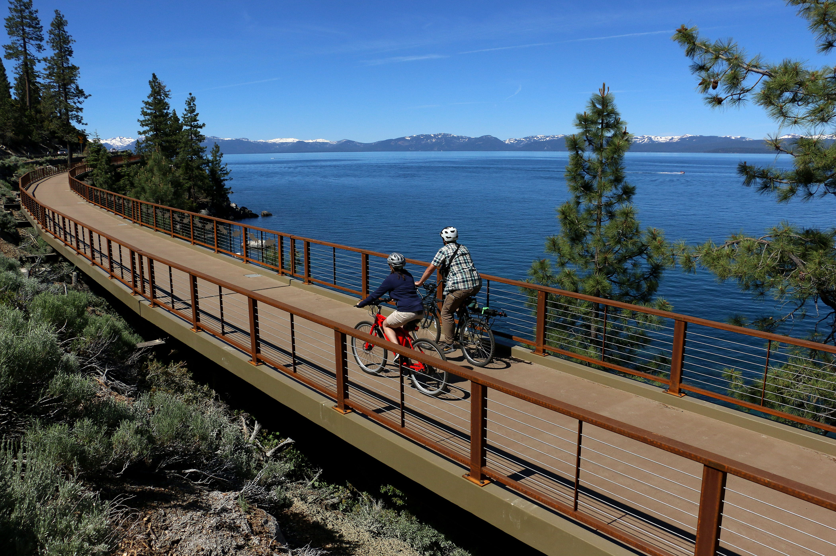
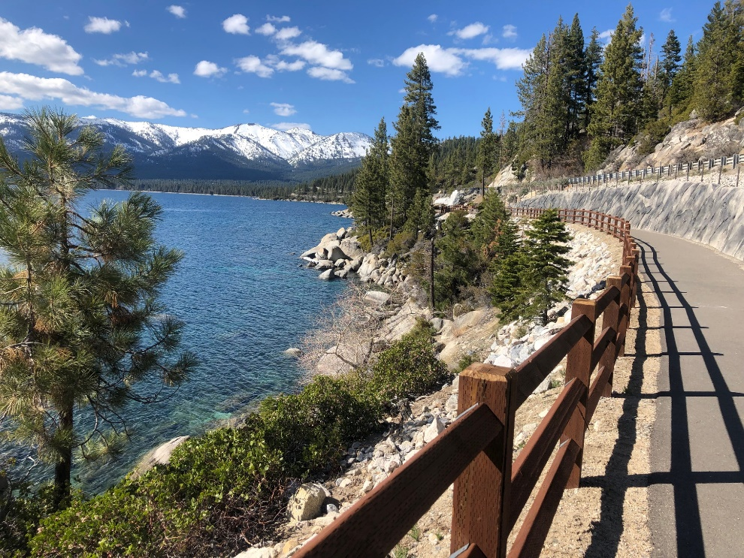
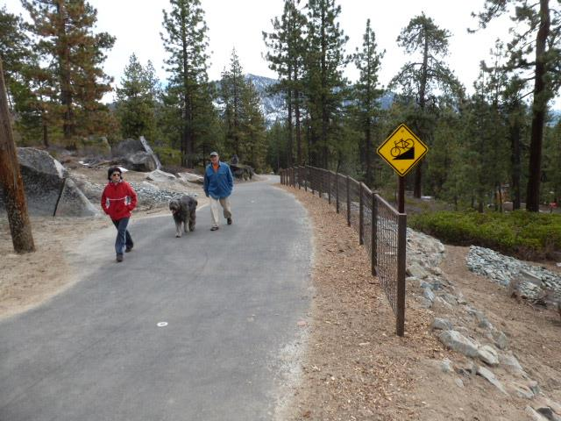
Nevada Stateline to Stateline Bikeway
Demonstration Projects Complete
Photo by RGJ.com
Photo by Nevadacapitalnews.org

Slide 7
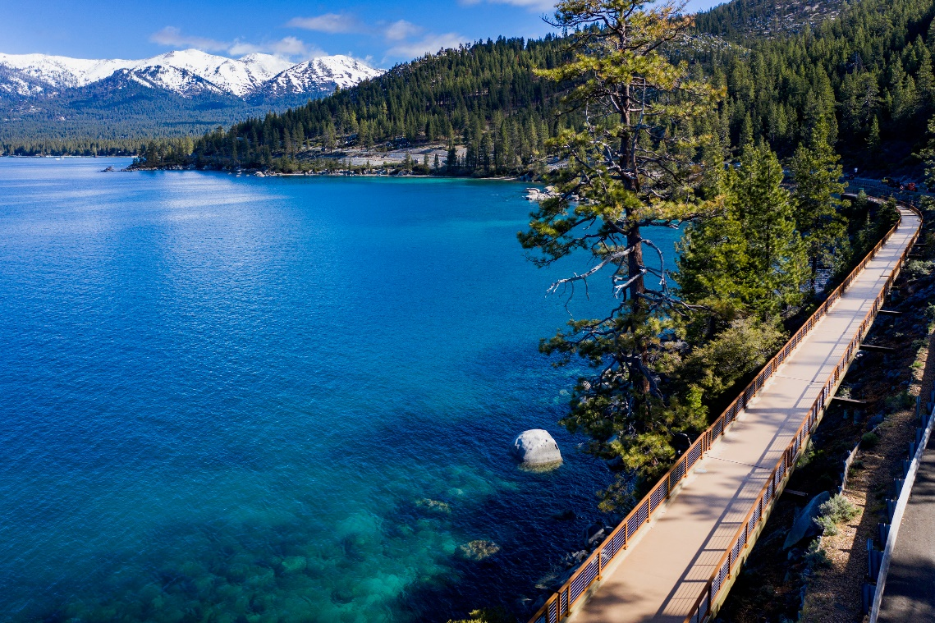
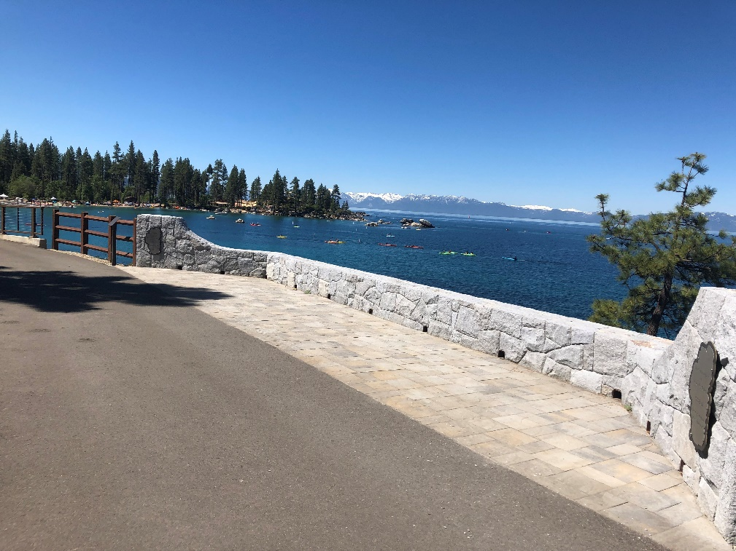
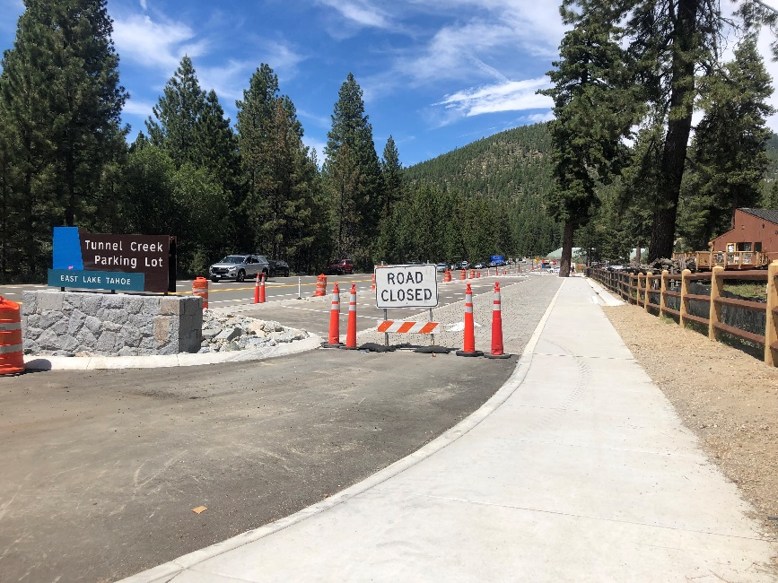
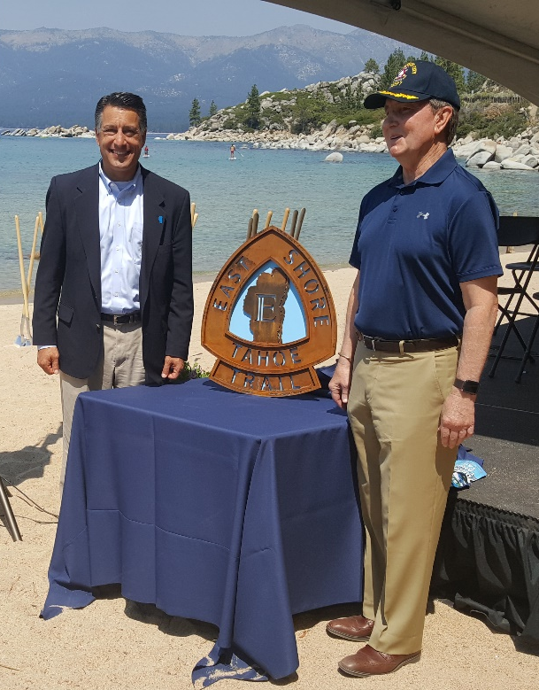
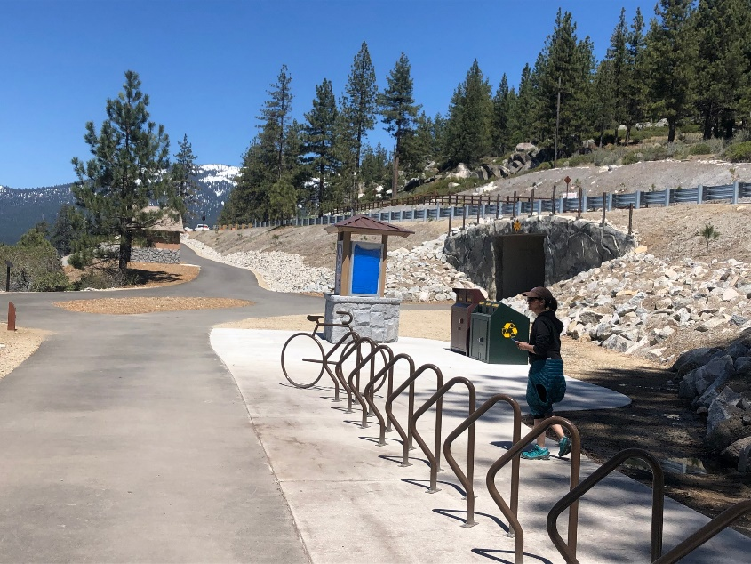
Tahoe East Shore Trail
Photo by RGJ.com

Slide 8
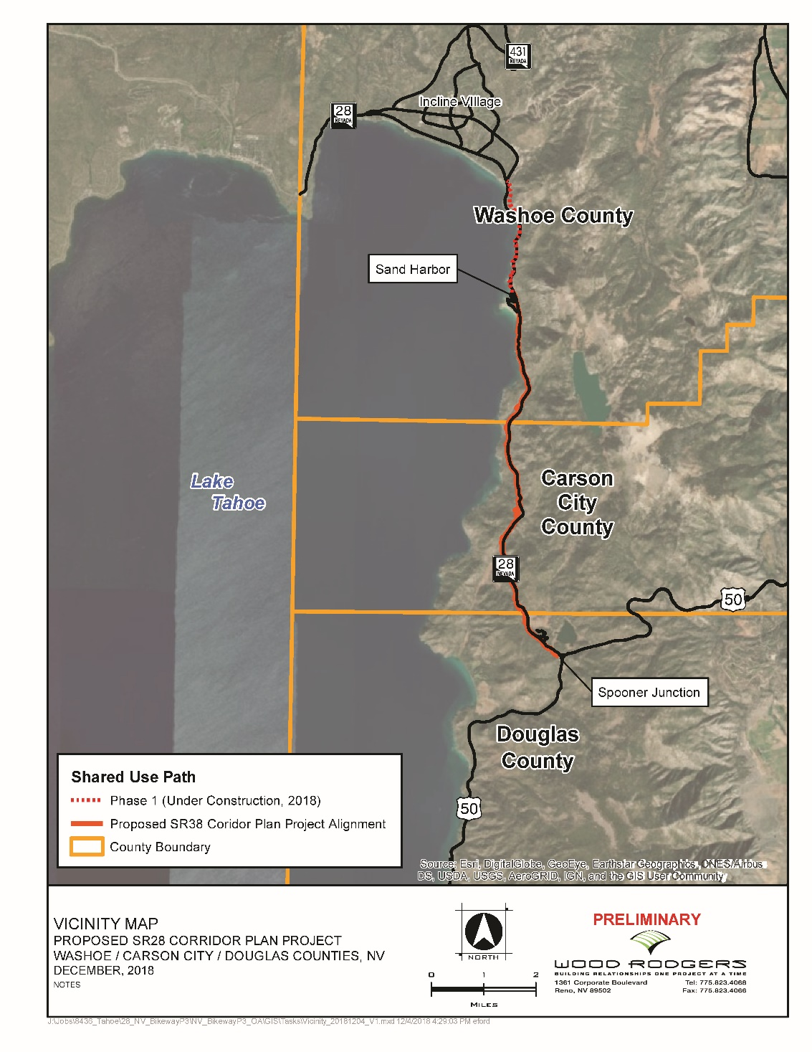


SR 28 Corridor Improvements – Sand Harbor to Spooner State Park
8 miles of Shared Use Path
Parking
  Expand 2 existing lots
  2 new lots
Utility Co-Location
  IVGID Effluent Line
  Power
  Fiber Optic
  Water Quality Improvements
TRPA AIS Station
Vista Points
Emergency Pull-Outs

Slide 9
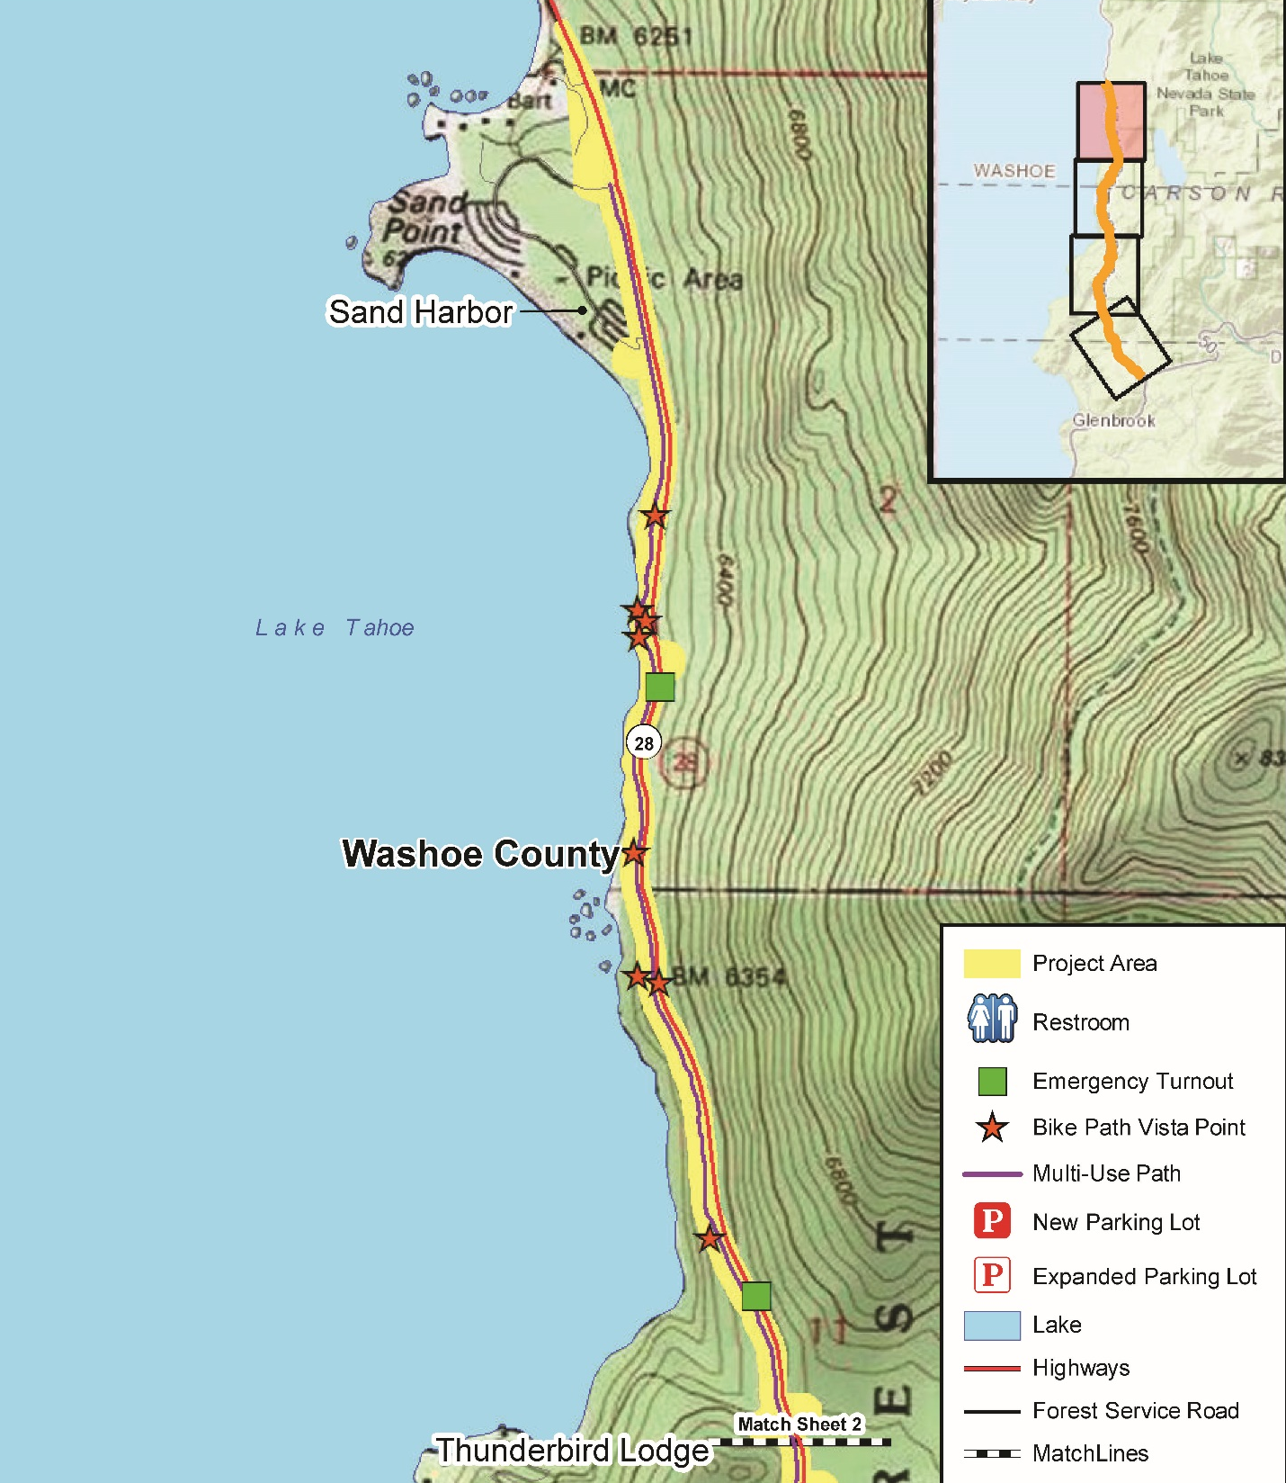

Slide 10
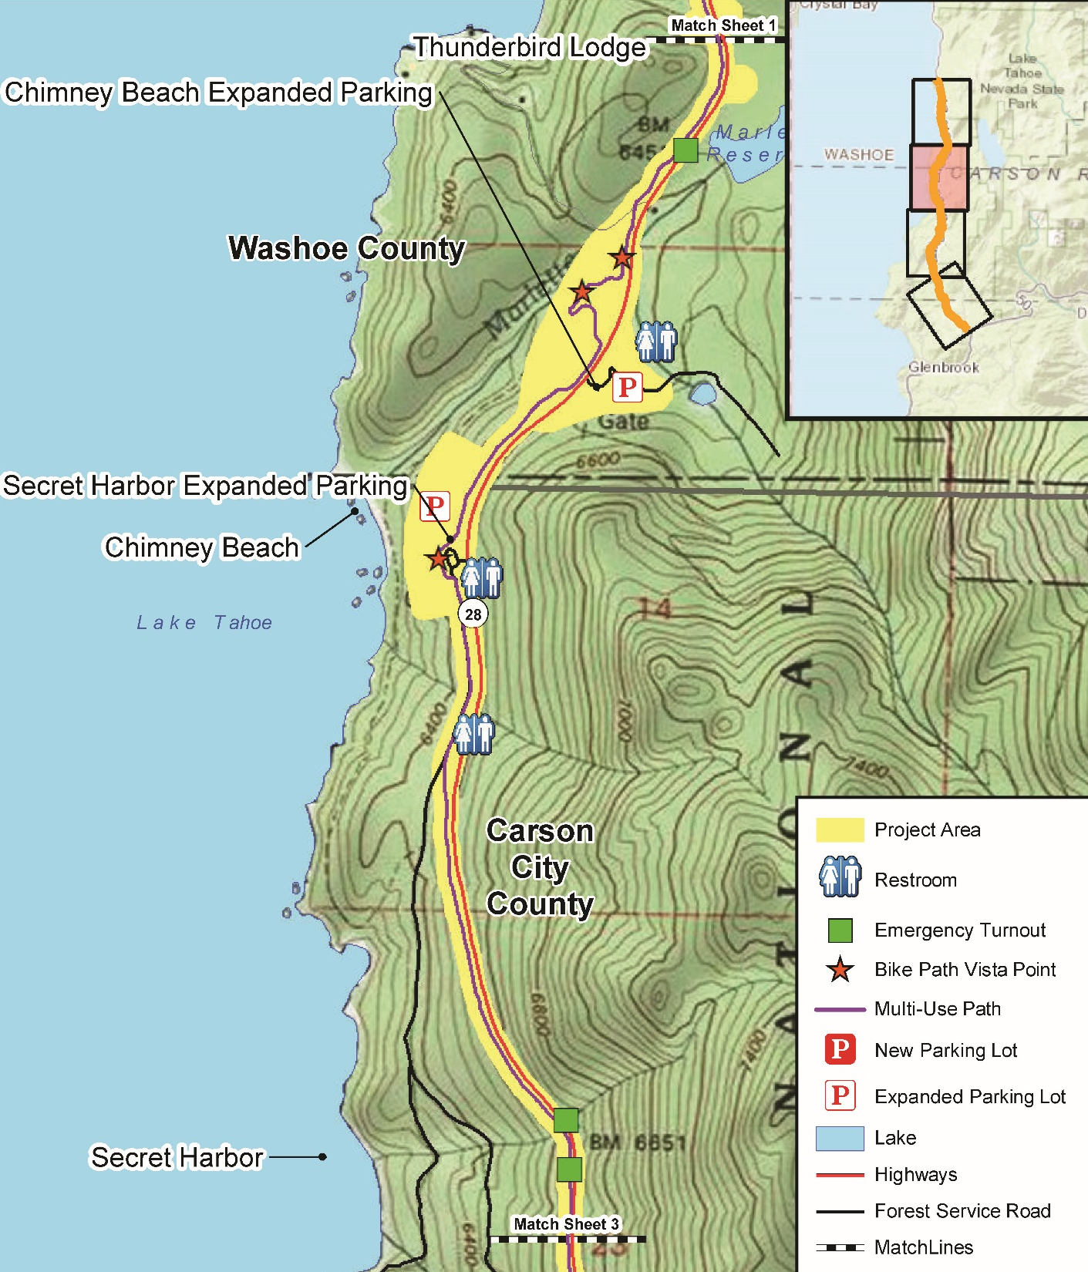

Slide 11
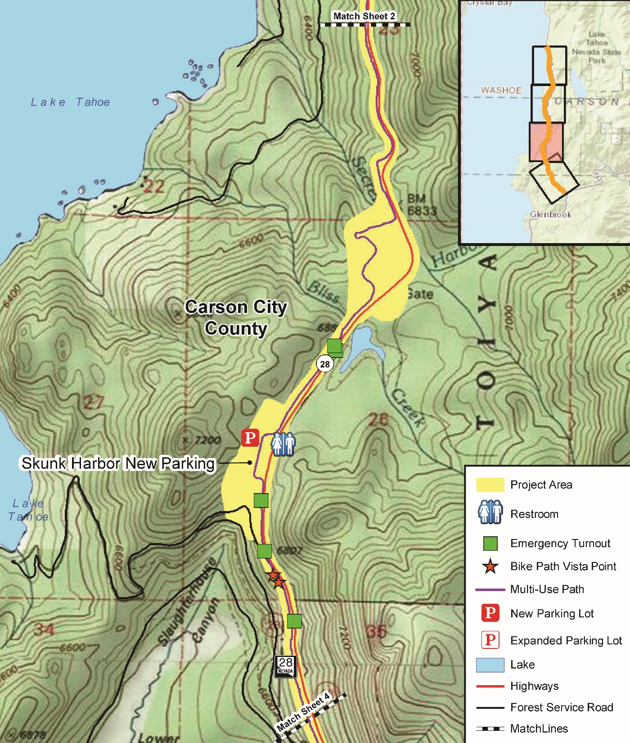

Slide 12
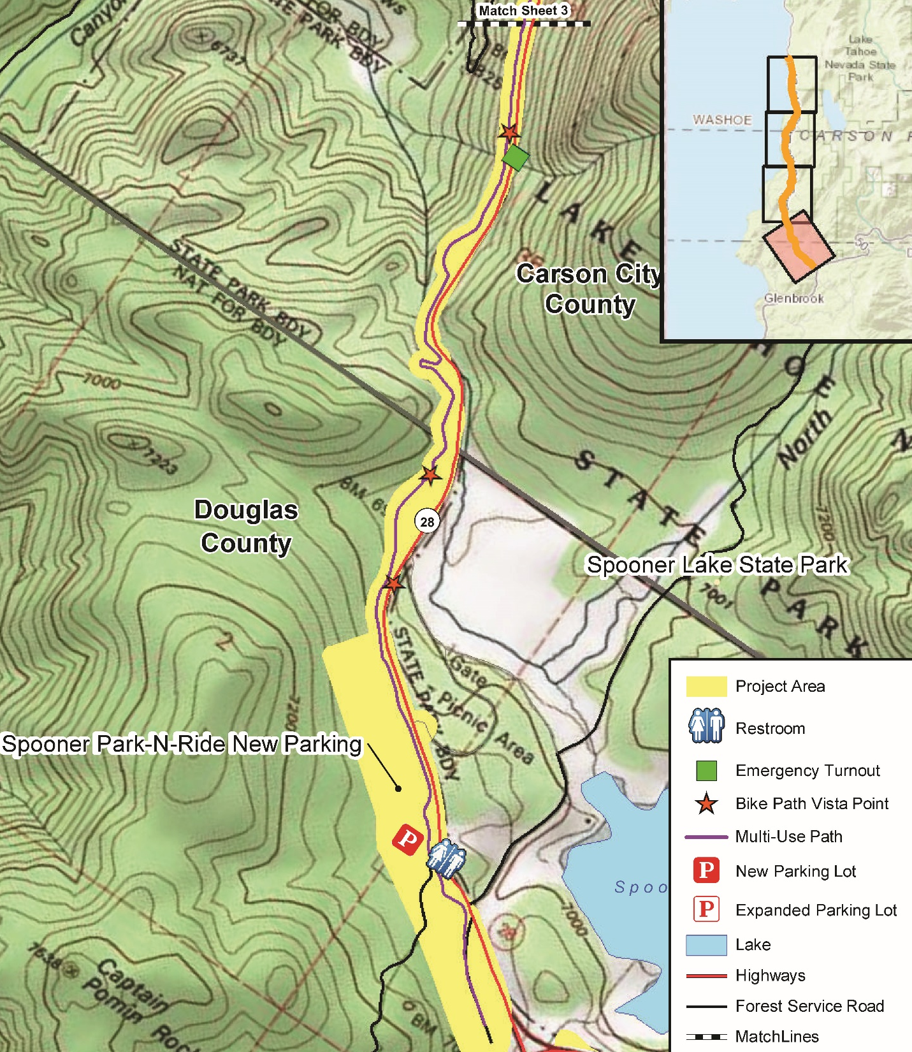

Slide 13
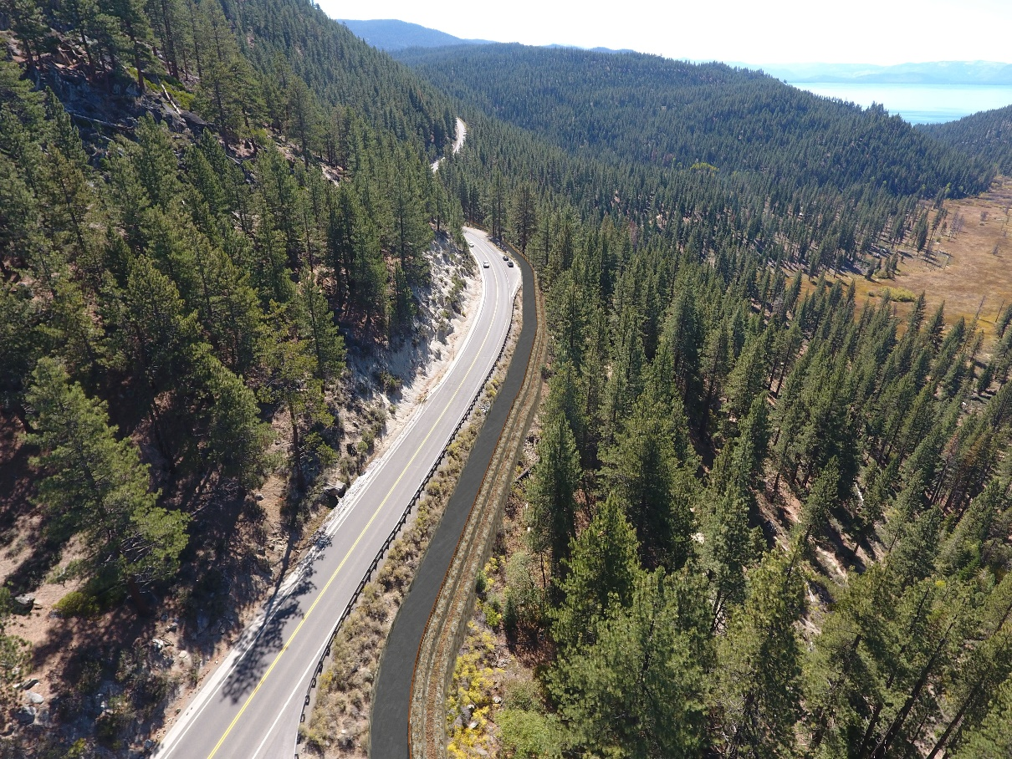
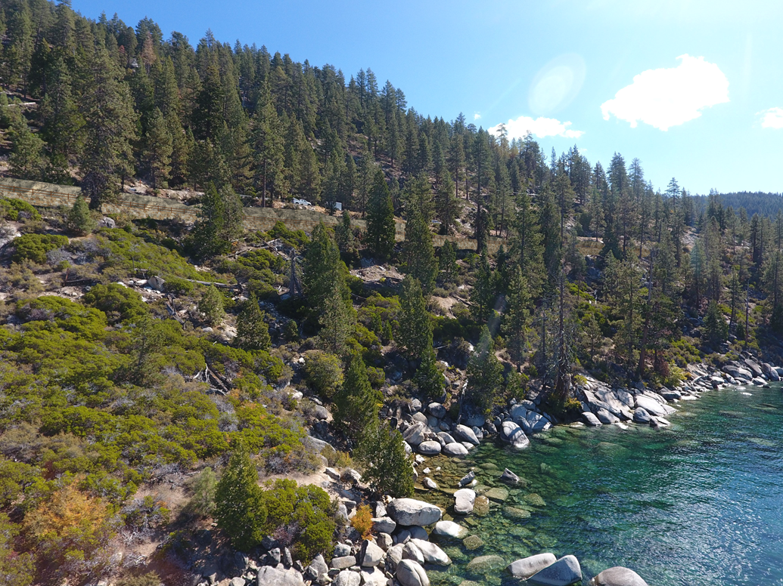
Shared Use Path
Benefits:
Safety
Environmental
Improved Access to Recreation
Utility Corridor

Slide 14
Parking Areas
Benefits:
Safe off-highway Parking
Trailhead Access
Restrooms
Water Quality
Safe Ped Crossing
Enforcement
  VPPP
  No Parking Zone

Slide 15
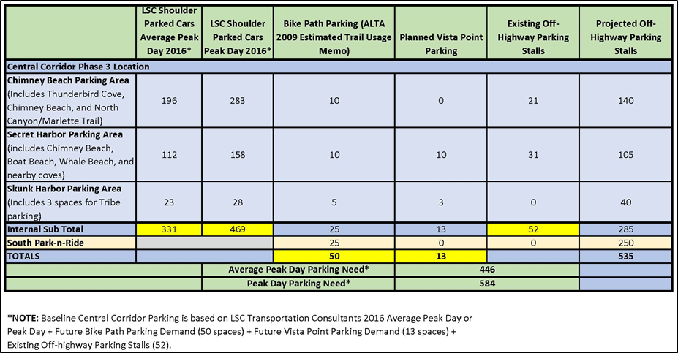
Parking Calculations

Slide 16
South Park N Ride Lot
Aquatic Invasive Species (AIS) Inspection Station

Slide 17
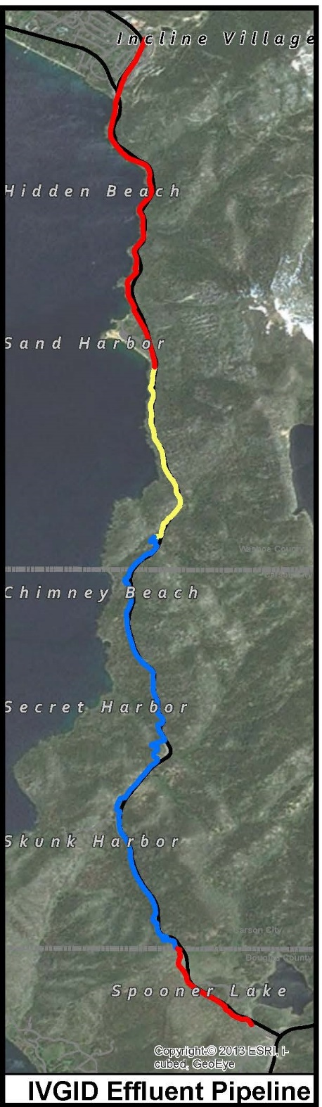
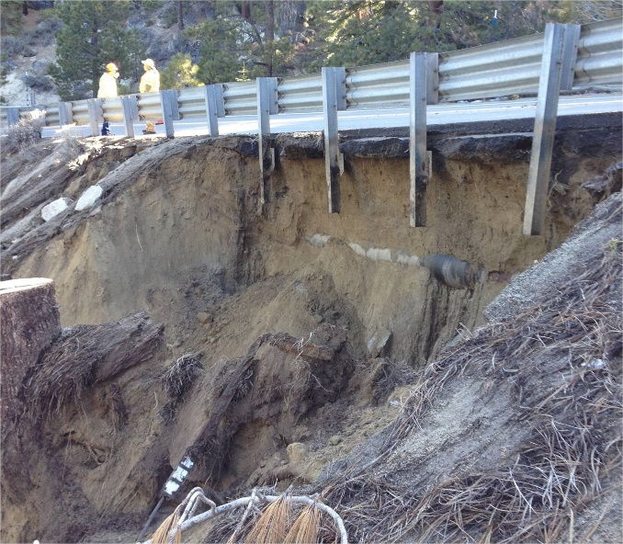
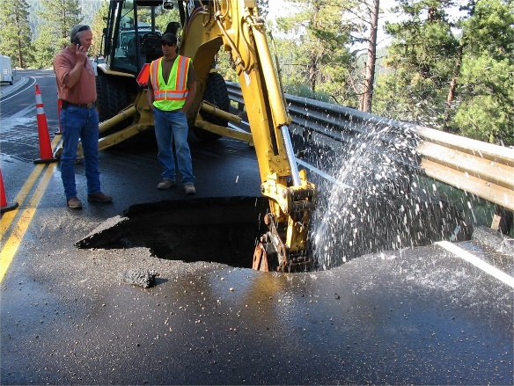
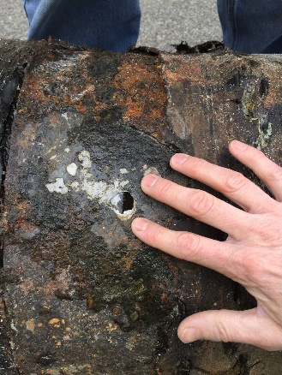
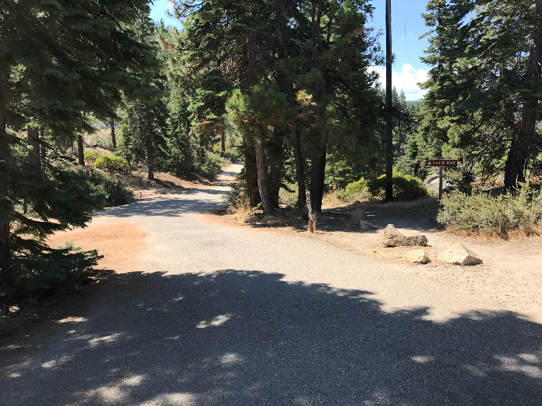
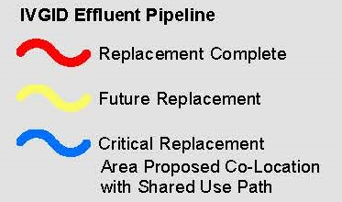
Utility Co-Location
Benefits:
Environmental
  Water Quality
  Reduce Fire Risk
  (Fire Hydrants)
Safety
Maintenance
Cost Savings
Existing Overhead
Future Path
Power/Communications

Slide 18
The SR 28 Corridor EA is available at:
https://go.usa.gov/xmgxT
Public Comment Period Closed August 11, 2019.

Slide 19
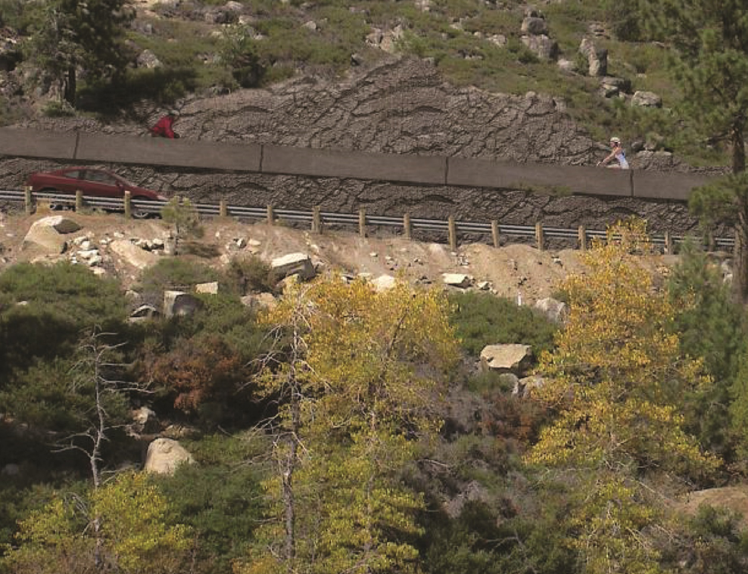
Future Crystal Bay to Incline Segment

Slide 20
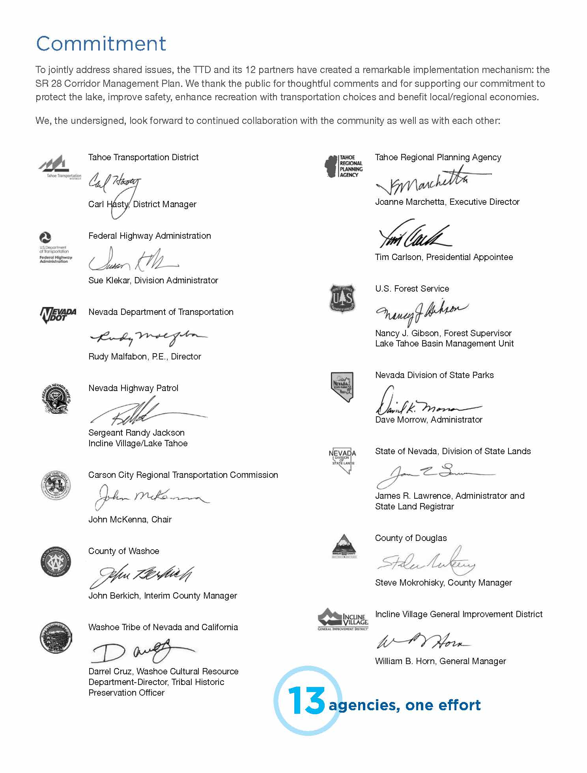
questions?

